Slide 1
Spring Hibernate Integration & Tx Mgt
Rajeev Gupta MTech CS Java Trainer & Consultant

Slide 2
Hibernate framework Overview

Slide 3
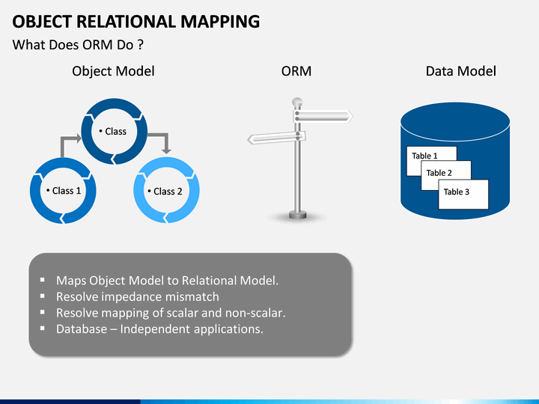
Hibernate ORM

Slide 4
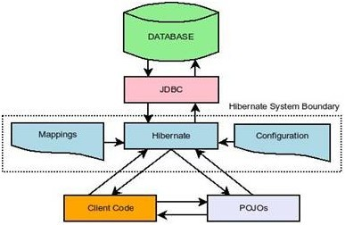
Hibernate architecture

Slide 5
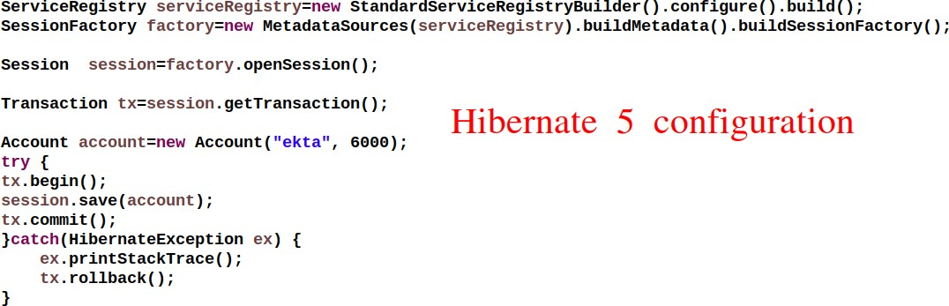
Hibernate Configuration

Slide 6
Hibernate Spring Integration

Slide 7
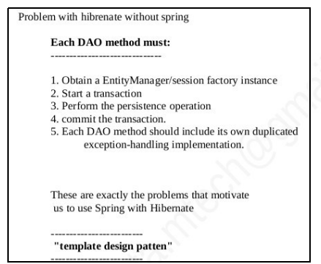
Problem with hibernate without spring

Slide 8
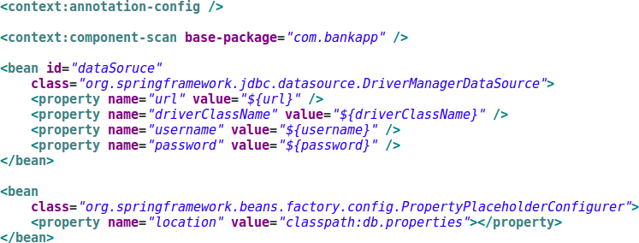
Spring Hibernate Configuration

Slide 9
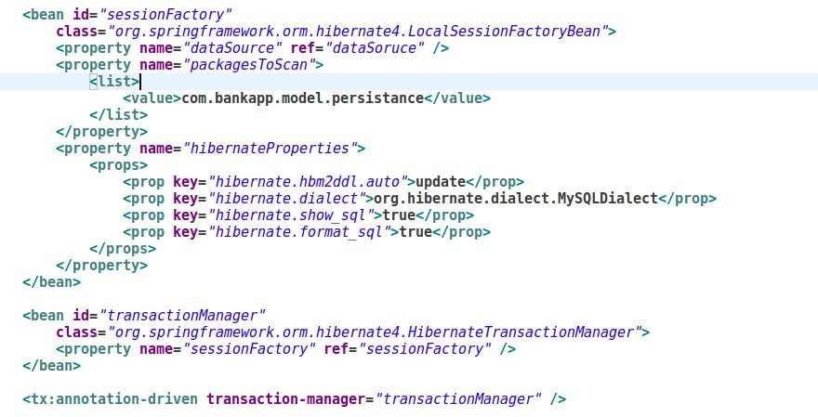
Spring Hibernate Configuration

Slide 10
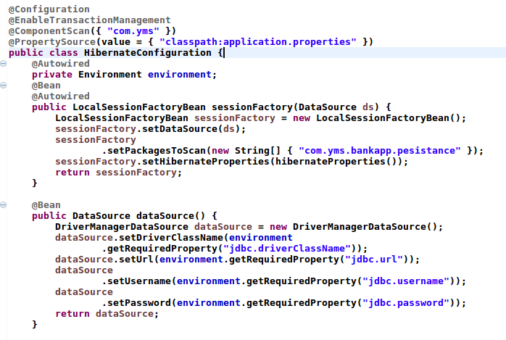
Spring Hibernate Configuration

Slide 11
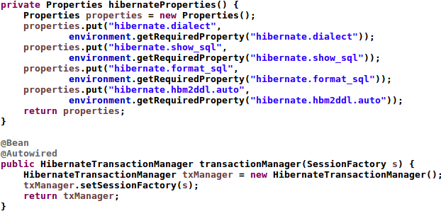
Spring Hibernate Configuration

Slide 12
Spring Tx Mgt

Slide 13
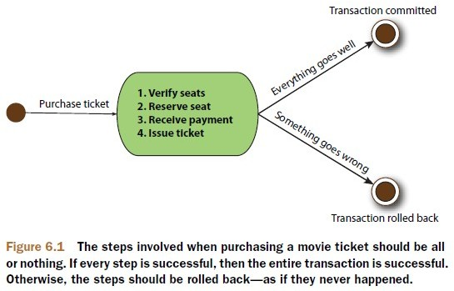
Need of Transaction Management
rgupta.mtech@gmail.com

Slide 14
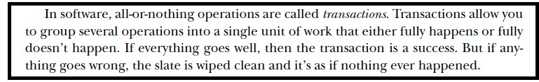
Transactions
▶ Transaction is a series of actions that must occur as a group. If any portion of the group of actions fails, the entire Transaction should fails.
▶ A.C.I.D. is the well-known acronym for the characteristics of a successful and valid transaction.
▶
Atomicity Consistency Isolation Durability
▶
▶
▶
rgupta.mtech@gmail.com

Slide 15
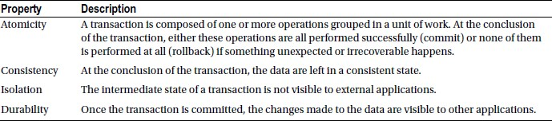
ACID properties
rgupta.mtech@gmail.com

Slide 16
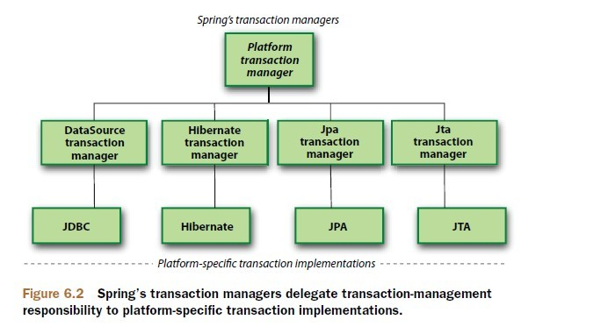
Spring tx support
▶
Spring doesn’t directly manage transactions.
Spring comes with a selection of transaction managers that delegate responsibility for transaction management to a platform- specific transaction implementation provided by either JTA or the persistence mechanism.
Each of these transaction managers acts as a facade to a platform- specific transaction implementation.
▶
▶
rgupta.mtech@gmail.com

Slide 17
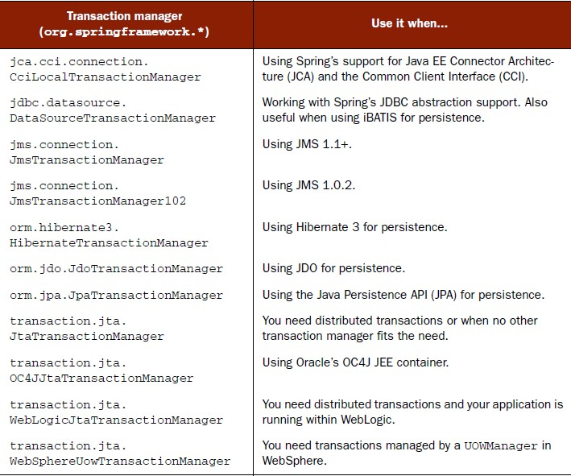
Spring supported transaction managers
rgupta.mtech@gmail.com

Slide 18

JDBC Transaction
▶
If we are using JDBC, springs DataSourceTransactionManager will handle transactional boundaries for us.
To use DataSourceTransactionManager, wire it into your application’s context definition using the following XML
▶
▶
Behind the scenes, DataSourceTransactionManager manages transactions by making calls on the java.sql.Connection object retrieved from the DataSource.
For instance, a successful transaction is committed by calling the commit() method on the connection. Likewise, a failed transaction is rolled back by calling the rollback() method.
▶
rgupta.mtech@gmail.com

Slide 19
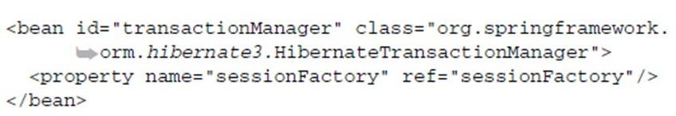
Hibernate transactions
▶
If we are using Hibernate then we need to configure HibernateTransactionManager
▶
The sessionFactory property should be wired with a Hibernate SessionFactory, here cleverly named sessionFactory
rgupta.mtech@gmail.com

Slide 20

Java Persistence API transactions
▶
If we are using JPA then we need to configure JpaTransactionManager
▶
We need to provide entitymanagerfactory configureation
rgupta.mtech@gmail.com

Slide 21
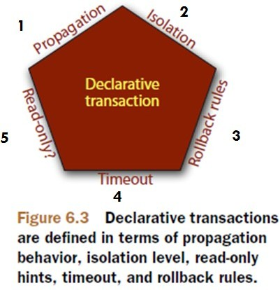
Defining transaction attributes
▶ In Spring, declarative transactions are defined with transaction attributes.
▶ A transaction attribute is a description of how transaction policies should be applied to a method.
▶ There are five facets of a transaction attribute
▶ Although Spring provides several mechanisms for declaring transactions, all of them rely on these five parameters to govern how transaction policies are administered.
▶ Regardless of which declarative transaction mechanism we use, we have to define these attributes
rgupta.mtech@gmail.com

Slide 22
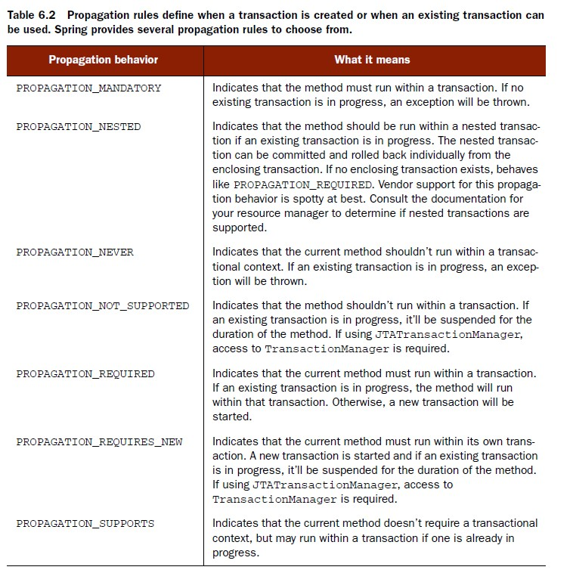
PROPAGATION BEHAVIOR
▶
Propagation behaviour defines the boundaries of the transaction with respect to the client and to the method being called.
rgupta.mtech@gmail.com

Slide 23
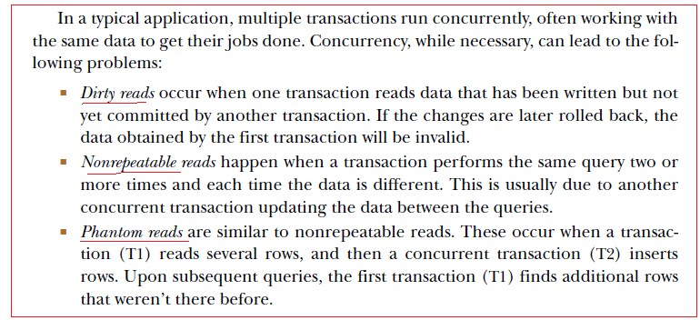
ISOLATION LEVELS
▶
An isolation level defines how much a transaction may be impacted by the activities of other concurrent transactions. Another way to look at a transaction’s isolation level is to think of it as how selfish the transaction is with the transactional data.
rgupta.mtech@gmail.com

Slide 24
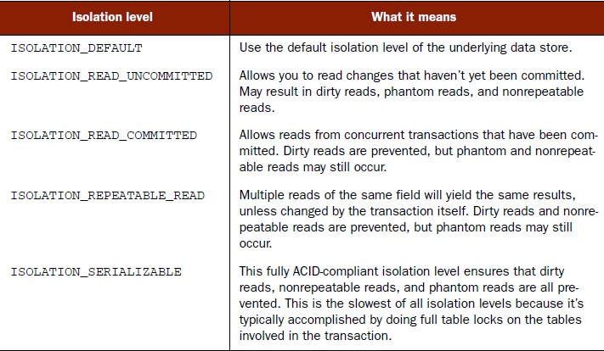

ISOLATION LEVELS
▶ Isolation levels determine to what degree a transaction may be impacted by other transactions being performed in parallel.
rgupta.mtech@gmail.com

Slide 25
READ-ONLY
▶
If a transaction performs only read operations against the underlying data store, the data store may be able to apply certain optimizations that take advantage of the read-only nature of the transaction.
By declaring a transaction as read-only, you give the underlying data store the opportunity to apply those optimizations as it sees fit.
▶
rgupta.mtech@gmail.com

Slide 26
TRANSACTION TIMEOUT
▶
Suppose that our transaction becomes unexpectedly long-running. Because trans- actions may involve locks on the underlying data store, long-running transactions can tie up database resources unnecessarily.
Instead of waiting it out, you can declare a transaction to automatically roll back after a certain number of seconds.
Because the timeout clock begins ticking when a transaction starts, it only makes sense to declare a transaction timeout on methods with propagation behaviors that may start a new transaction (PROPAGATION_REQUIRED, PROPAGATION_REQUIRES_NEW, and PROPAGATION_NESTED).
▶
▶
rgupta.mtech@gmail.com

Slide 27
ROLLBACK RULES
▶
By default, transactions are rolled back only on runtime exceptions and not on checked exceptions. (This behaviour is consistent with rollback behaviour in EJBs.)
But you can declare that a transaction be rolled back on specific checked exceptions as well as runtime exceptions.
Likewise, you can declare that a transaction not roll back on specified exceptions, even if those exceptions are runtime exceptions. Now that you’ve had an overview of how transaction attributes shape the behaviour of a transaction, let’s see how to use these attributes when declaring transactions in Spring.
▶
▶
rgupta.mtech@gmail.com

Slide 28
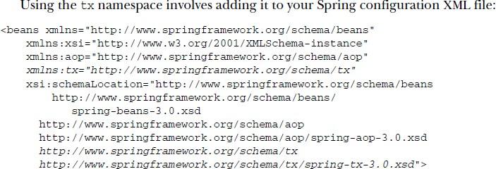
Declaring transactions in XML
▶
Spring offers a tx configuration namespace that greatly simplifies declarative transactions in Spring.
rgupta.mtech@gmail.com

Slide 29
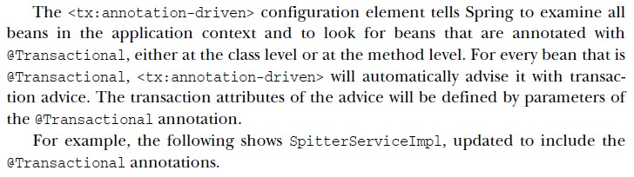
Defining annotation-driven transactions
▶
<tx:advice> element, the tx namespace provides the <tx:annotation- driven> element.
Using <tx:annotation-driven> is often as simple as the following line of XML:
▶
▶
<tx:annotation-driven/> That’s it!
<tx:annotation-driventransaction manager="txManager"/>
▶
rgupta.mtech@gmail.com

Slide 30
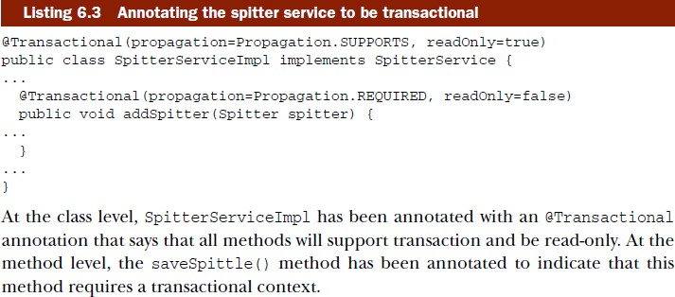
Defining annotation-driven transactions
rgupta.mtech@gmail.com

